Slide 1
ACCY577 Machine Learning for Accounting
Module 4: Model Evaluation
Linden Lu

Slide 2
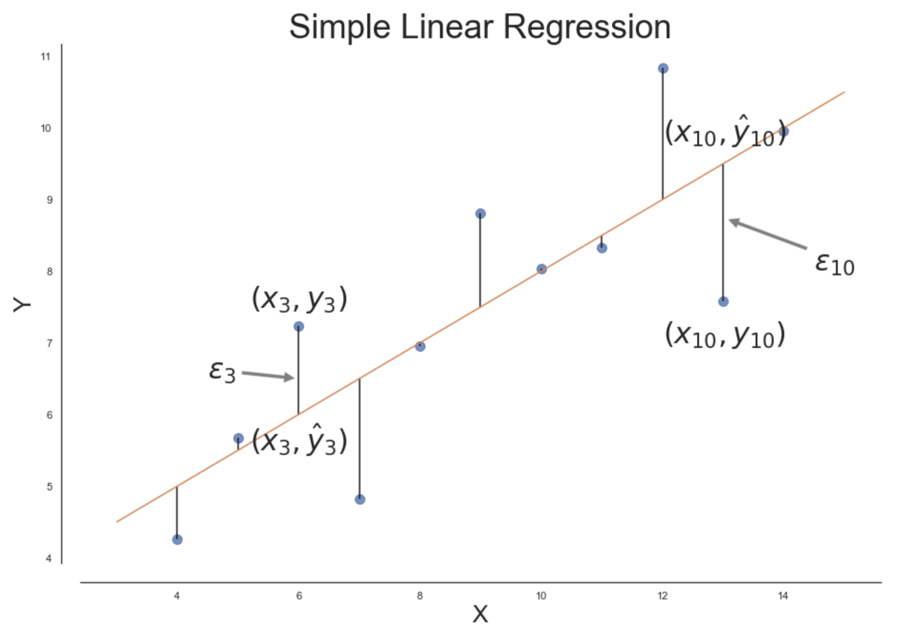
Lesson 1: Regression Evaluation
Evaluation Metrics for Regression
Mean Absolute Error (MAE)
Mean Squared Error (MSE)
Root Mean Squared Error (RMSE)
R-squared ( 𝑅2 )

Slide 3
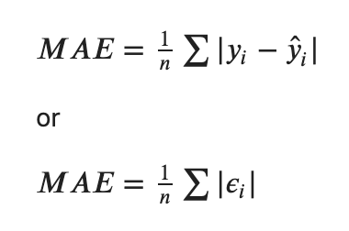
Mean Absolute Error (MAE)

Slide 4
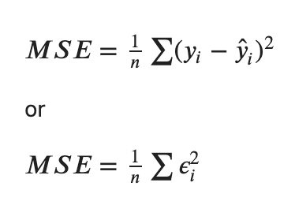
Mean Squared Error (MSE)

Slide 5
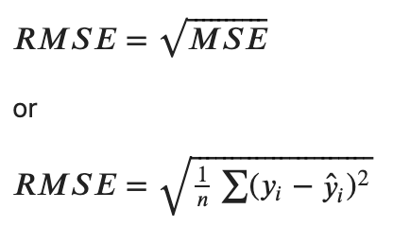
Root Mean Squared Error (RMSE

Slide 6
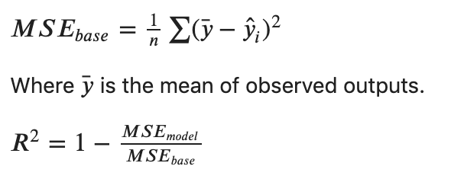
R Squared

Slide 7
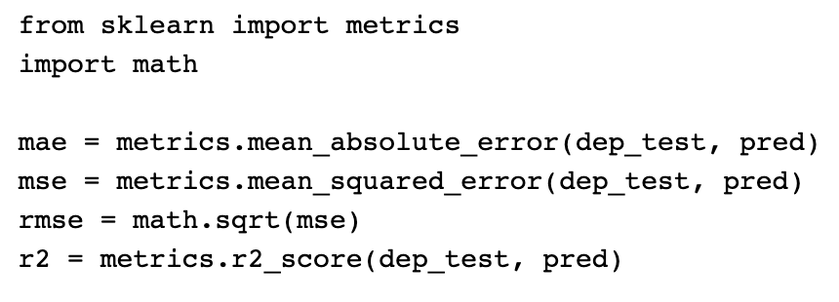
Regression Metric Calculation

Slide 8
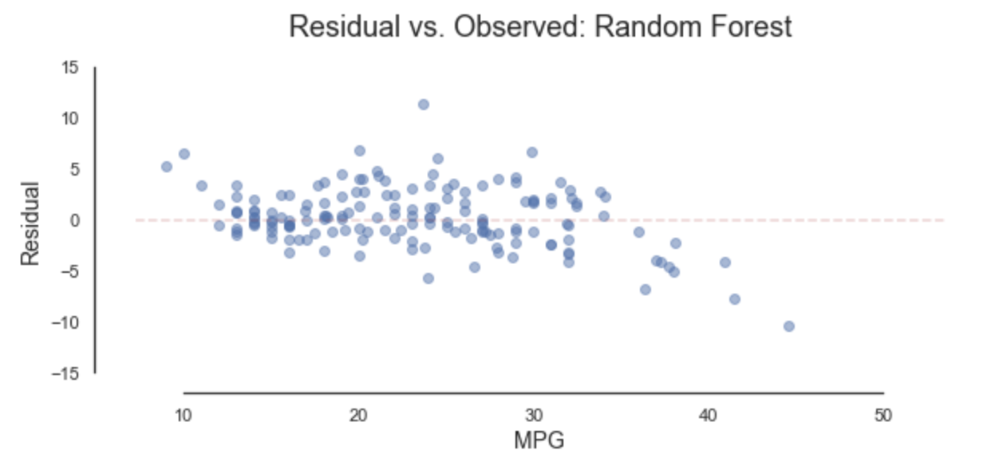
Residual vs. Observed Plot

Slide 9
Lesson 2: Classification Evaluation I
Evaluation Metrics for Classification
Accuracy Score
Classification Report
Confusion Matrix

Slide 10
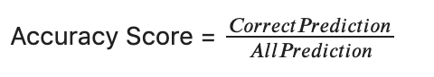
Accuracy Score

Slide 11
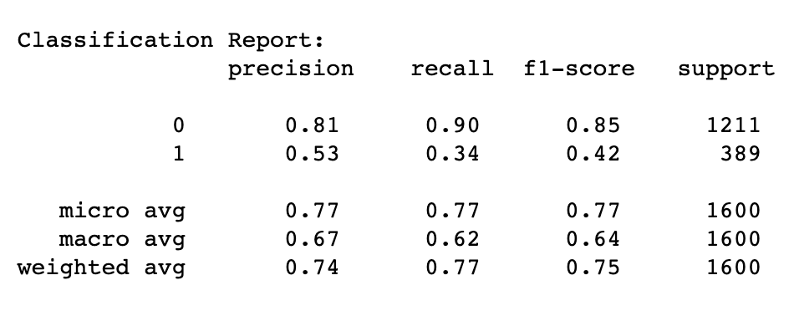
Classification Report
Precision: The proportion of the prediction that is correct.
Recall: Proportion of actual class that is predicted correctly.

Slide 12
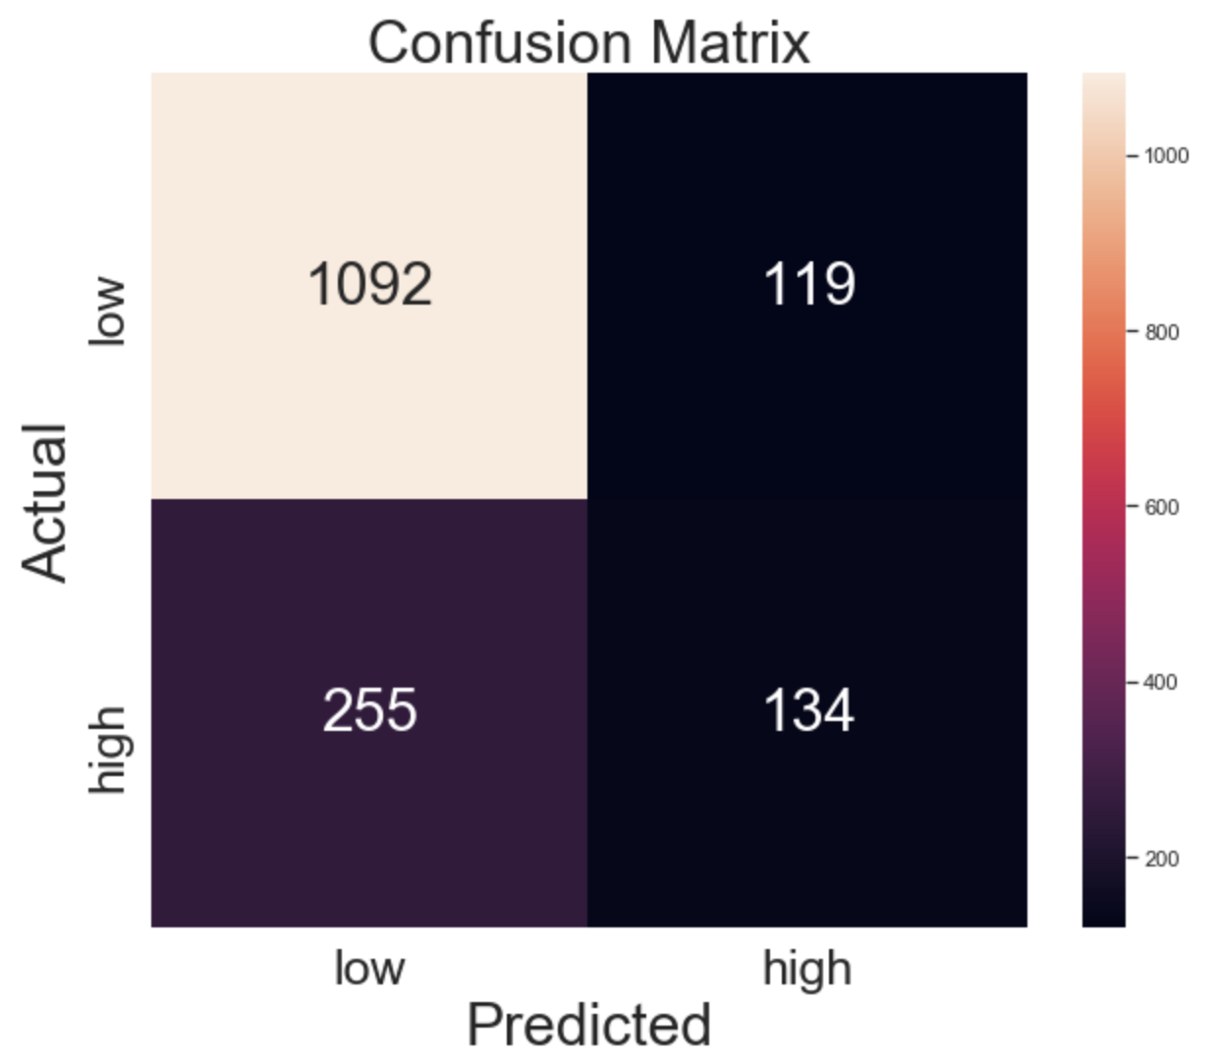
Confusion Matrix

Slide 13
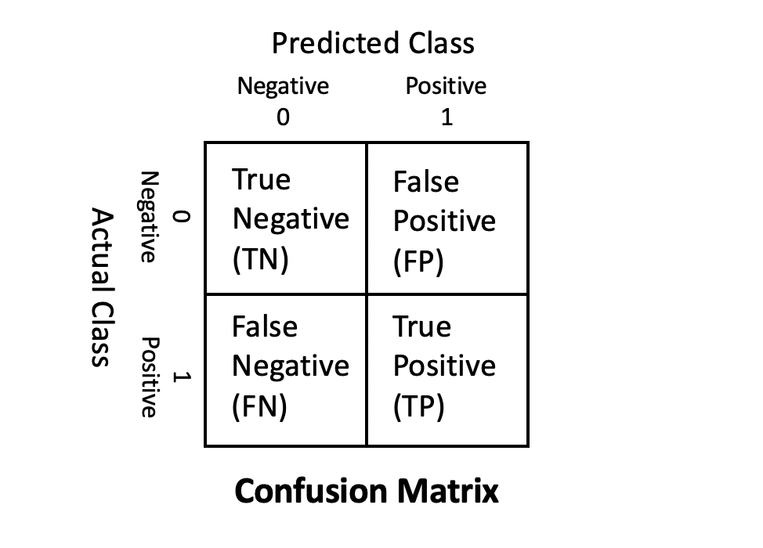
Confusion Matrix
True Negative (TN)
Total number of predicted negatives that are actually negative.
False Negative (FN) aka Type 2 Error
Total number of predicted negatives that are actually positive.
True Positive (TP)
Total number of predicted positives that are actually positive.
False Positive (FP) aka Type 1 Error
Total number of predicted positives that are actually negative.

Slide 14
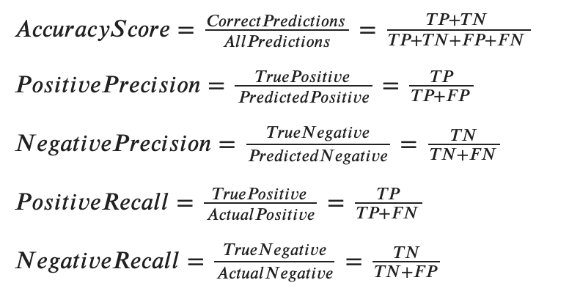
Metrics Calculation

Slide 15
Type 1 and Type 2 Error
When to Avoid Type 1 Error(False Positive)
Criminal trial
When to Avoid Type 2 Error(False Negative)
Cancer screening test

Slide 16

Classification Case Study: Direct Mail Marking
Case 1: Reach to as many target customers as possible(high positive recall)
Case 2: Reduce mails to wrong target customers(high positive precision

Slide 17
Adjust class_weight Hyperparamter
class_weight
None(default):
Give all classes same weight
Balanced
Give weights inversely proportional to class frequencies
custom weight
class_weight = {0:0.8, 1:0.2}

Slide 18
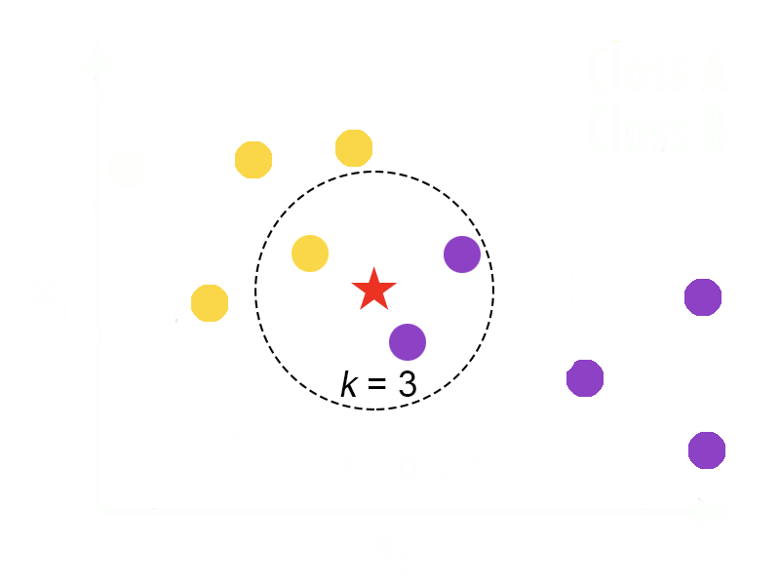
Adjust Class Weight

Slide 19
Lesson 3: Classification Evaluation II
ROC
Receiver operating characteristic
AUC
Area under curve

Slide 20
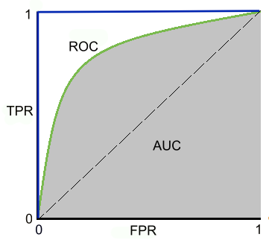
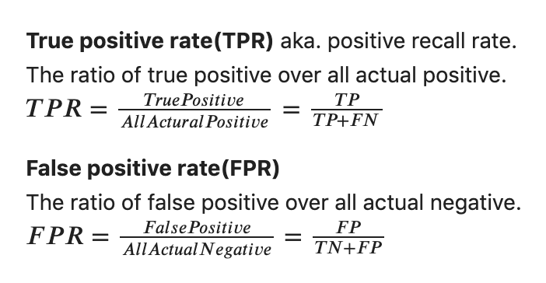
ROC & AUC

Slide 21
Plot ROC
Classifiers that have decision_function():
Logistic Regression
Support Vector Machine
Classifiers that have predict_proba():
K-nearest Neighbors
Decision Tree
Random Forest

Slide 22
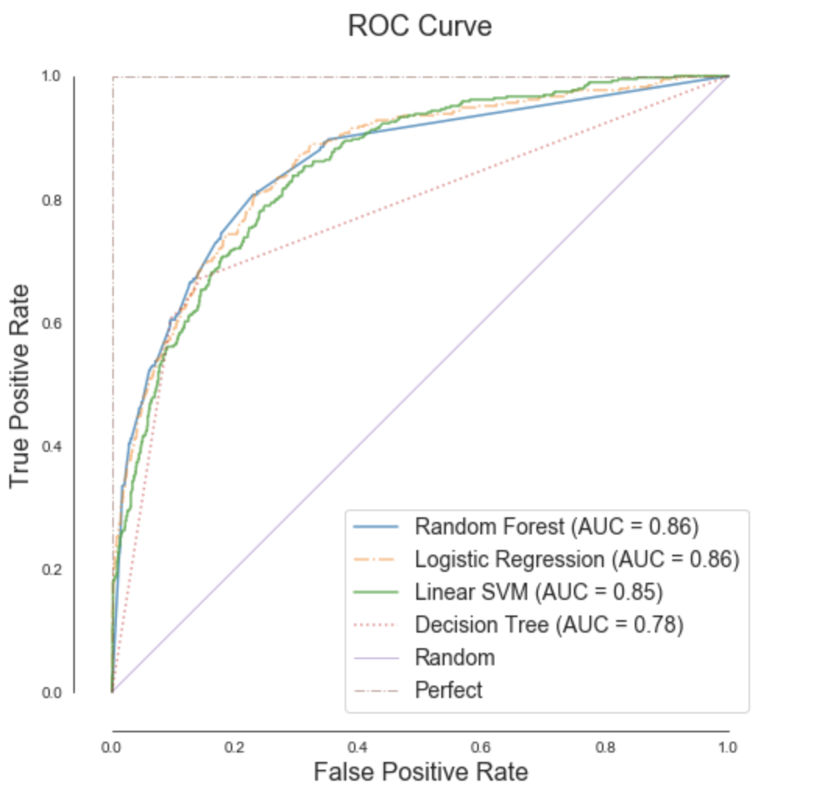
Compare Models with ROC&AUC

Slide 23
Module 4 Review
Model Evaluation
Regression
Classification

Slide 24
Regression Model Evaluation Metrics
Mean Absolute Error (MAE)
Mean Squared Error (MSE)
Root Mean Squared Error (RMSE)
R-squared ( 𝑅2 )

Slide 25
Residual vs. Observed Plot

Slide 26
Classification Model Evaluation Metrics
Accuracy Score
Classification Report
Confusion Matrix
Type 1 error(False positive)
Type 2 error(False negative)

Slide 27
Compare Models with ROC

